Slide 1
Assimilation of Point/Spatial Data and Risk assessment
10/19/2020

Slide 2
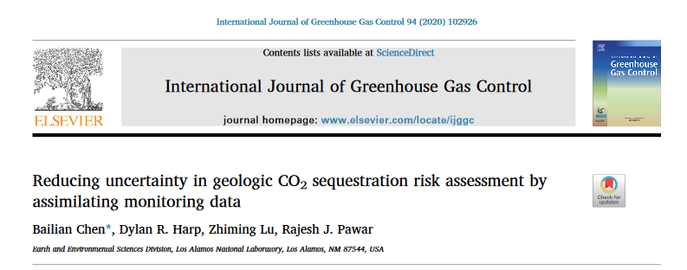
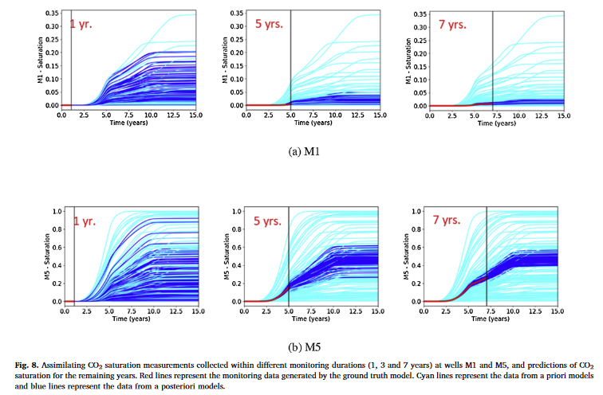
History matching point data
The variability in the predictions of CO₂ S. is reduced by assimilating monitoring data after different monitoring durations
The reduction in variability increases with increased monitoring data assimilation

Slide 3
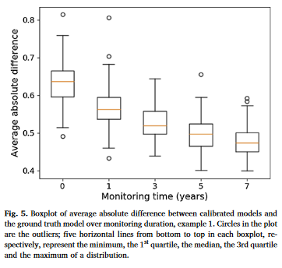
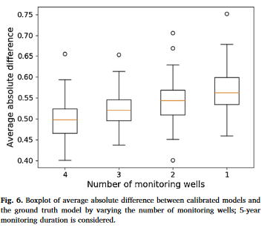
History matching point data

Slide 4
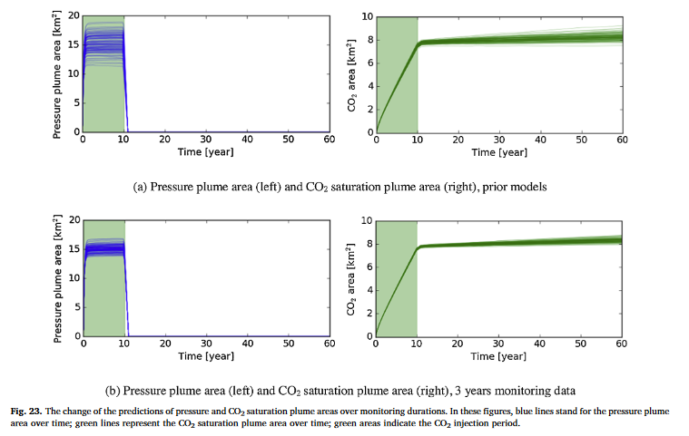
History matching point data

Slide 5
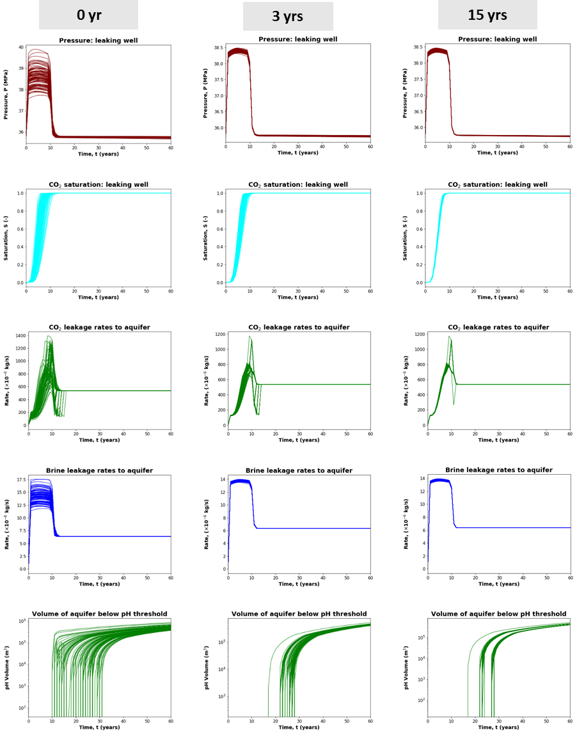

History matching point data
Uncertainty reduction in risk quantities based on assimilation of point data is significant.
Will spatial data (e.g., spatial CO₂ saturations from seismic) bring in additional benefits for uncertainty reduction?

Slide 6
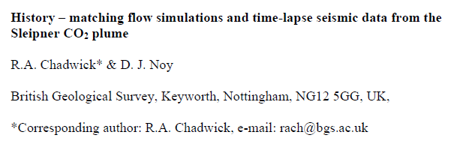
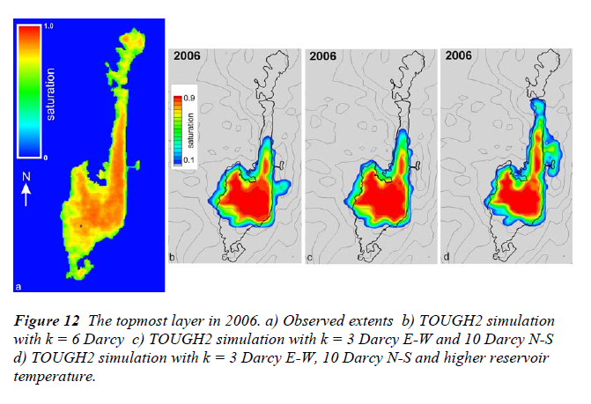
History matching CO₂ plume area (spatial data)
(Literature review)
Seismic data was converted to spatial CO₂ saturation data
Manual history matching!!!

Slide 7
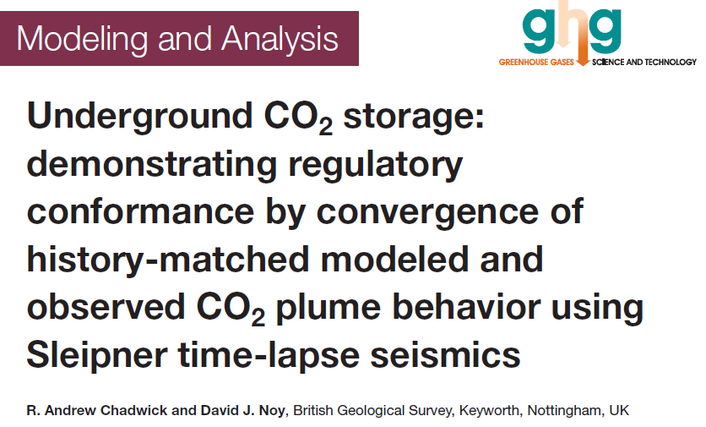
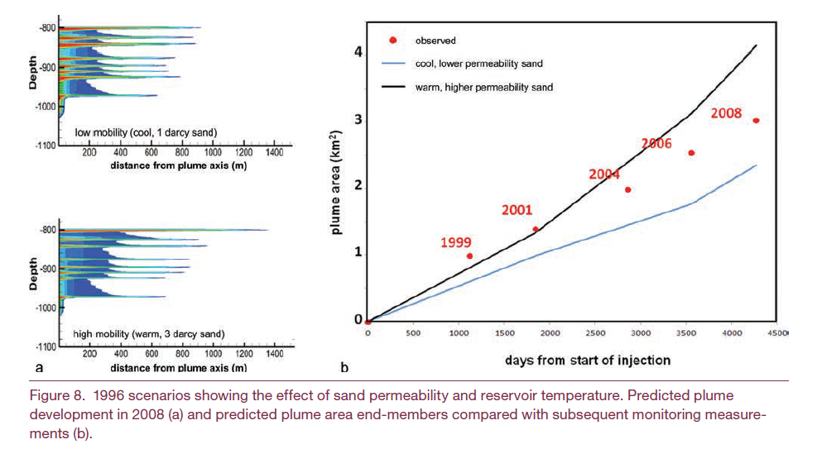
History matching CO₂ plume area (spatial data)
(Literature review)
Seismic data was converted to spatial CO₂ saturation data
Manual history matching!!!

Slide 8
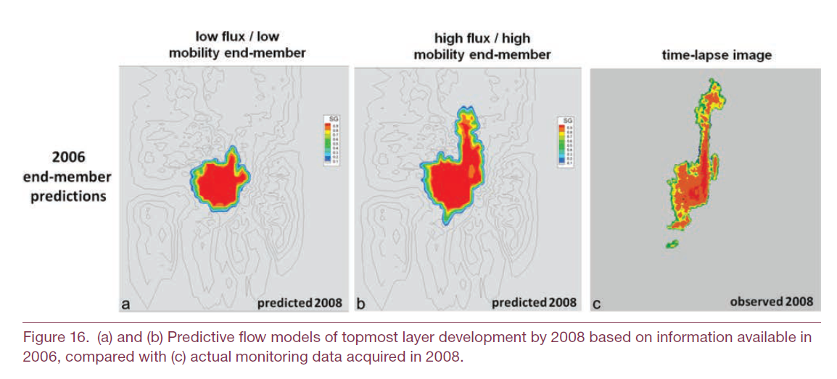
History matching CO₂ plume area (spatial data)
(Literature review)
Seismic data was converted to spatial CO₂ saturation data
Manual history matching!!!

Slide 9
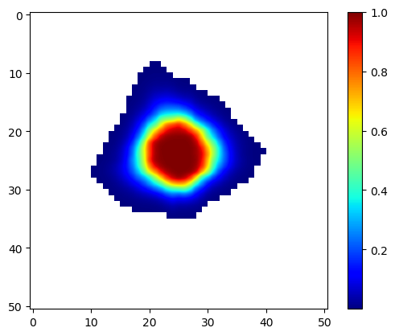
Should we conduct assisted history matching?
Approach: Use ES-MDA to assimilate time-varying spatial CO₂ saturation data (from 4D seismic) into reservoir model
Outcomes: History matched simulated and observed spatial CO₂ saturation data; updated reservoir permeability and porosity fields
How: Use all the gridblock by gridblock saturation data within the plume area? Similar like placing a monitoring well at each gridblock within the plume extent
Ground truth saturation map

Slide 10
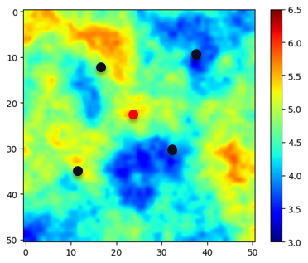
Spatial data assimilation: Case study
Same synthetic example as we used for our previous work
Ground truth

Slide 11
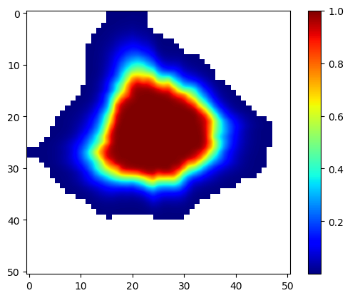
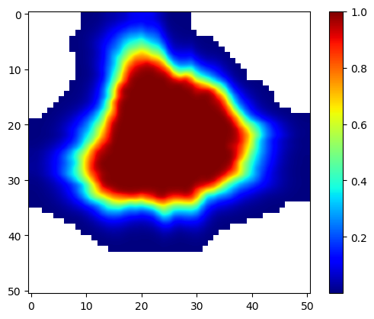
CO₂ saturation maps – 4D Seismic
1 yr
3 yrs
5 yrs

Slide 12
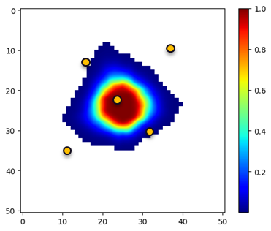
Assimilation of 1-yr saturation map
1 yr

Slide 13
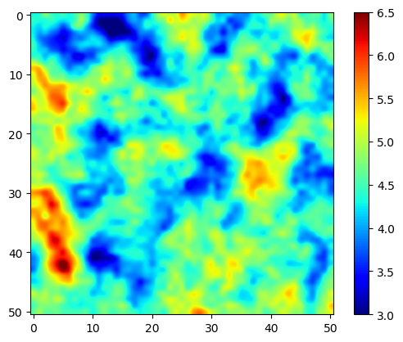
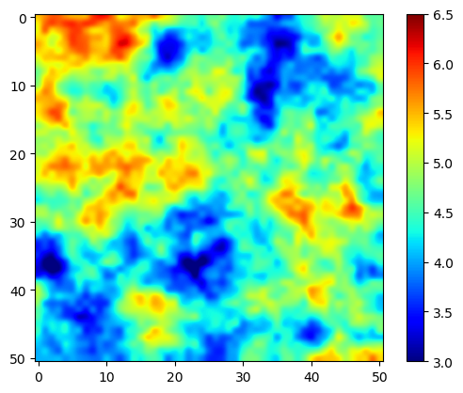
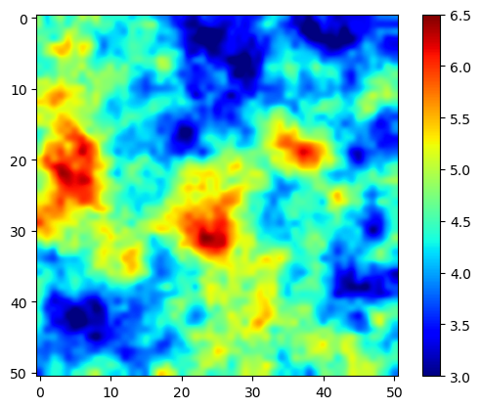
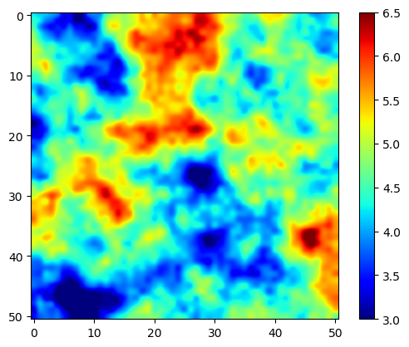
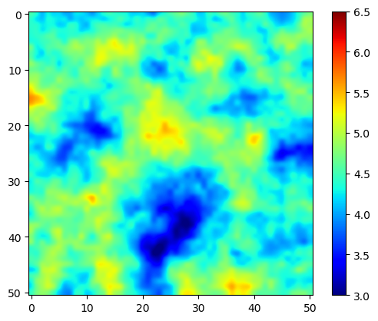
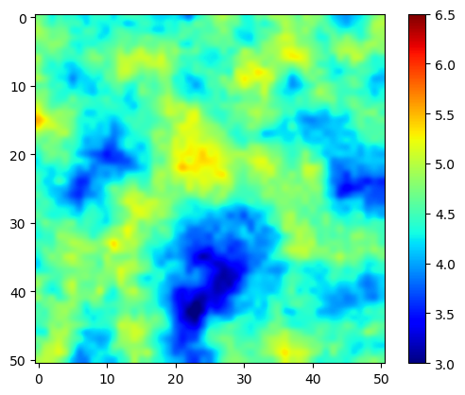
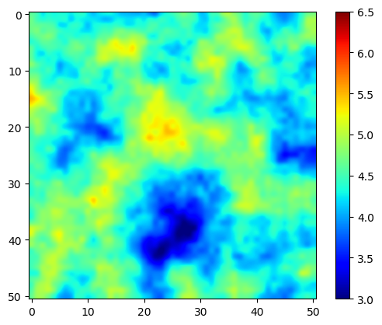
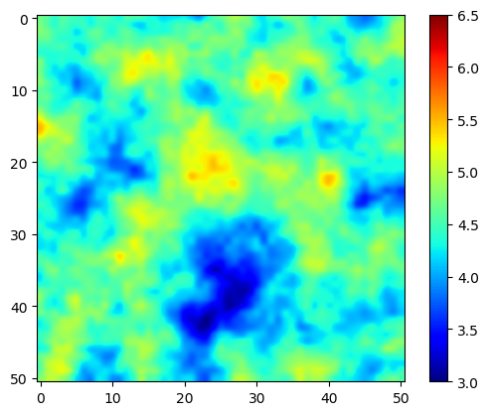
Prior and updated models
R1
R2
R3
R4
Prior
Updated
Ground truth

Slide 14
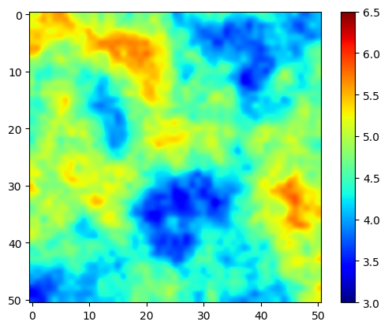
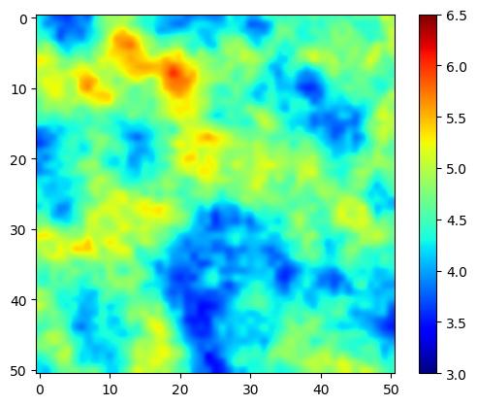
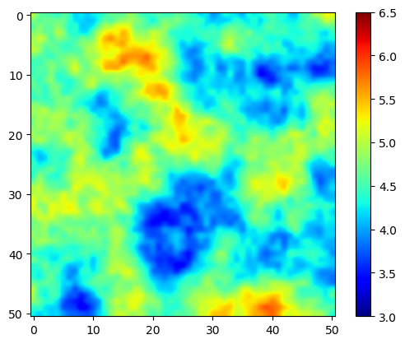
Model updating (R1)
Ground Truth
Prior
1 yr
3 yrs
5 yrs

Slide 15
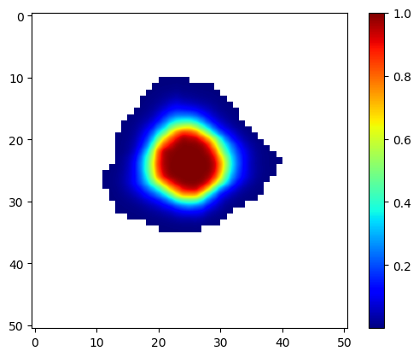
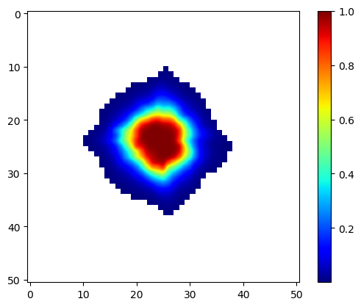
CO₂ saturation plume history matching (1 yr)
Observational CO2 saturation map
History matched CO2 saturation map (R1)
Prior (R1)

Slide 16
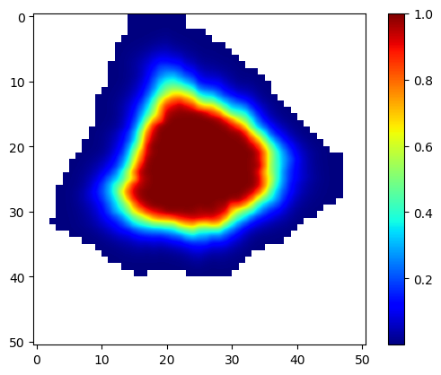
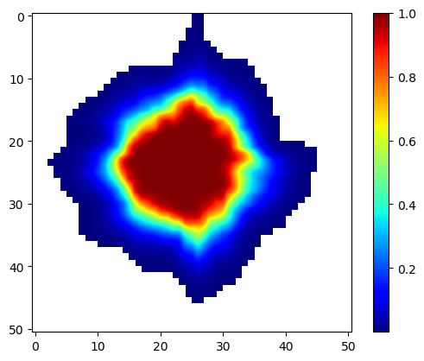
CO₂ saturation plume history matching (3 yrs)
Observational CO2 saturation map
History matched CO2 saturation map (R1)
Prior (R1)

Slide 17
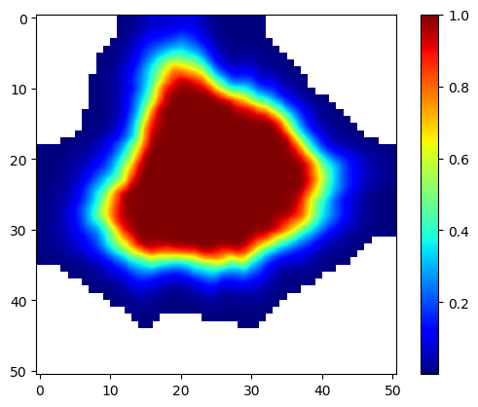
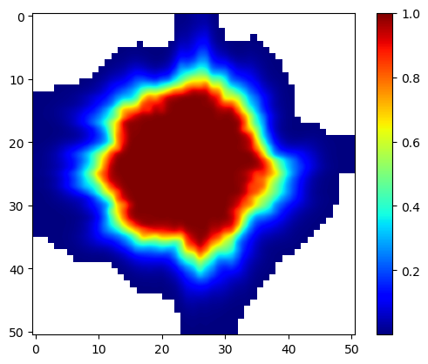
CO₂ saturation plume history matching (5 yrs)
Observational CO2 saturation map
History matched CO2 saturation map (R1)
Prior (R1)

Slide 18
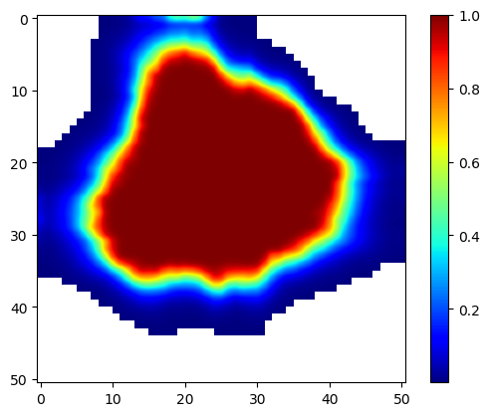
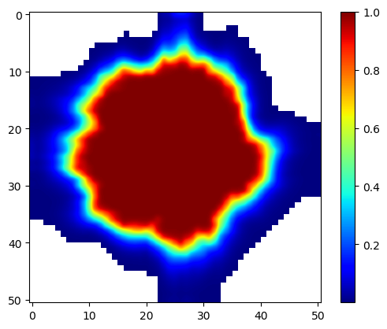
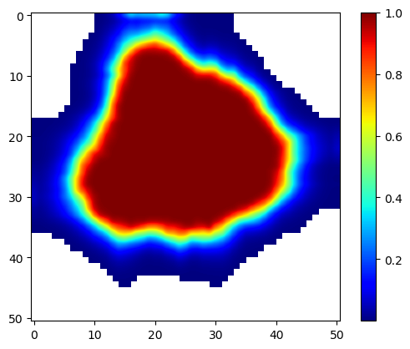
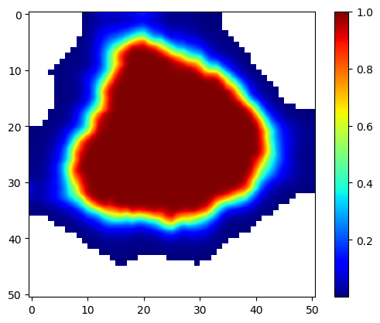
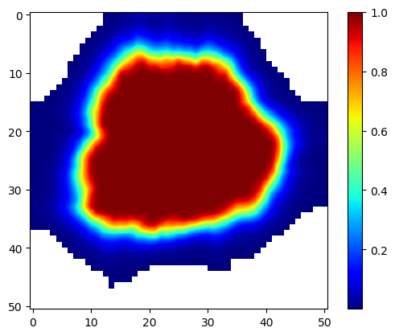
CO₂ saturation plume prediction at 15 yrs (R1)
“True” map
Prior map
5 yrs
3 yrs
1 yr

Slide 19
CO₂ saturation maps – 4D Seismic (hypothetical)
1 yr
3 yrs
5 yrs

Slide 20
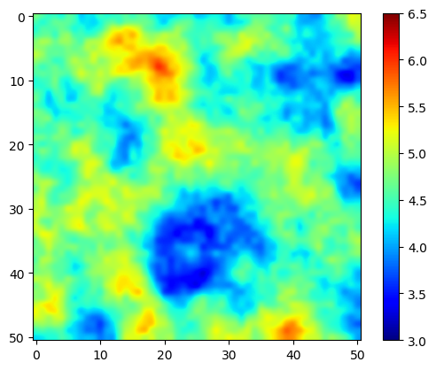
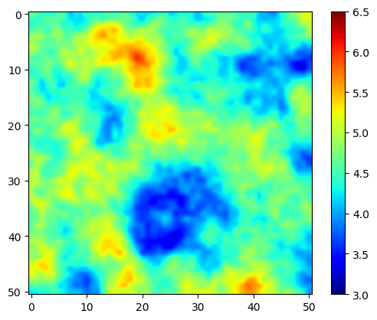
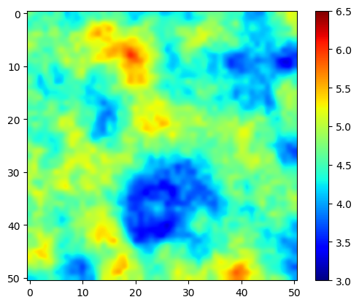

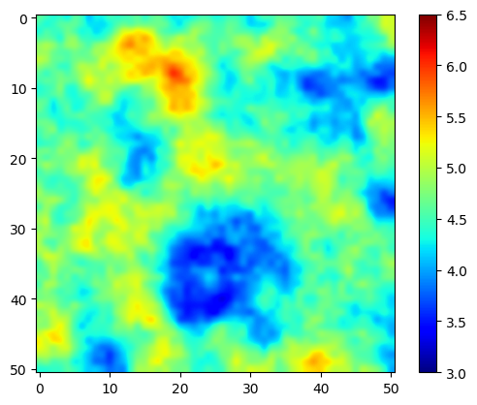

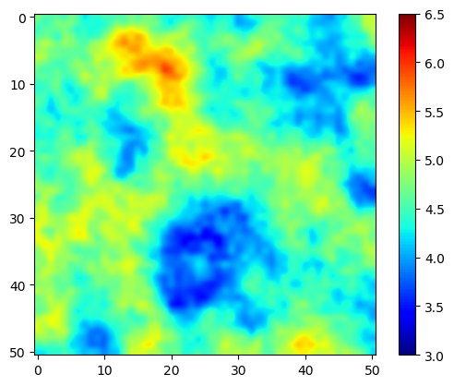
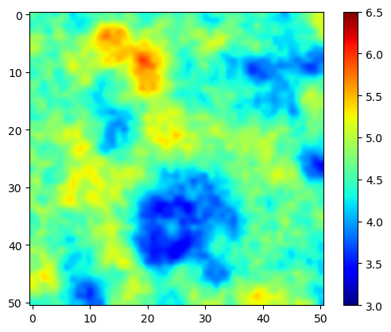

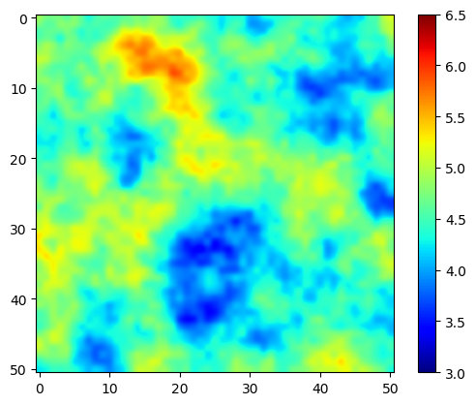
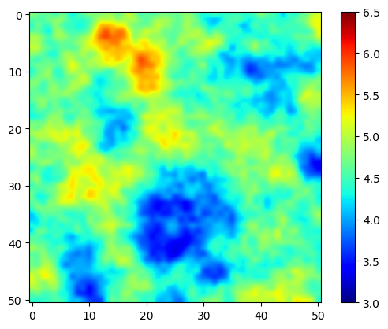
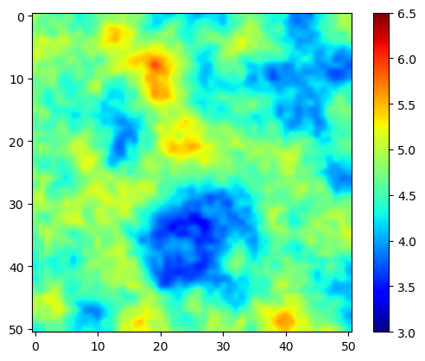
Impact of the level of data noise
1%
3%
Ground truth
5%
10%
1 yr
3 yrs
5 yrs

